Slide 1
2.4 Problems of Rural Entrepreneurship

Slide 2
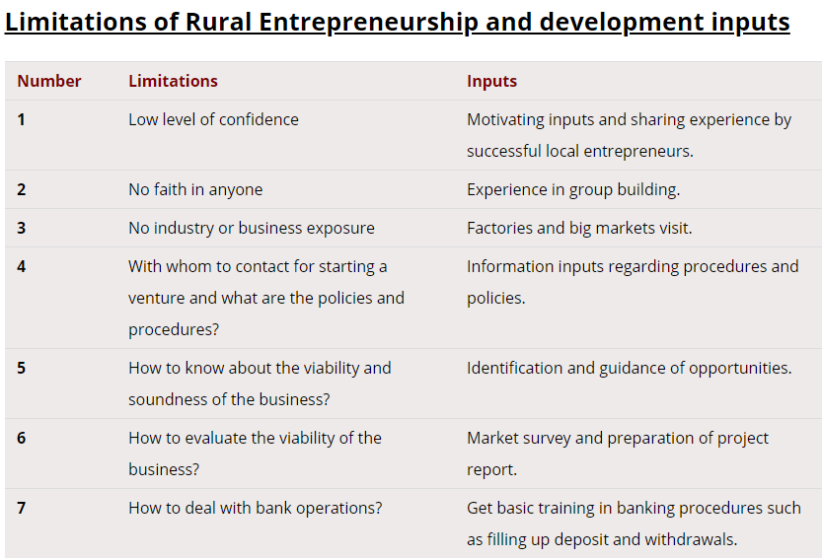

Slide 3
Problems
Financial problems
  Paucity of funds
  Lack of infrastructural facilities
  Risk element
Marketing problems
  Competition
  Middle men

Slide 4
Problems (contd.)
Management problems
  Lack of knowledge of IT
  Legal formalities
  Lack of technical knowledge
  Poor quality products
Human resource problems
  Low skill level of workers
  Negative attitude

Slide 5
Remedial Measures
Creation of finance cells
Concessional rates of interest
Offering training facilities
Proper supply of raw materials
Setting up marketing co-operatives

