Slide 1
ACCOUNTING FOR MANAGERIAL DECISION

Slide 2
UNIT – I
Accounting for Decision making – Scope and Importance – Decision Accounting vs. Financial Accounting and Cost Accounting.

Slide 3
Definition of Accounting
Eric L. Kohler defines accounting as “ the procedure of analysis, classification and recording transaction in accordance with a preconceived plan for the benefit of (a) providing a means by which an enterprise can be conducted in an orderly fashion, and (b) establishing a basis for reporting the financial condition of an enterprise and the results of its operations”.

Slide 4
Management Accounting
Meaning : It is the study of managerial aspects of accounting it is a tool in the hands of management to exercise decision making. The emphasis of management accounting is to redesign accounting in a manner which is helpful to the management is framing the policies and control of their execution.
Definition: Batty’s definition describe Management Accounting as a combination of various accounting system and techniques which are designed to meet the needs of the management.

Slide 5
Characteristics of management accounting
Providing Financial Information.
Cause and effect analysis
Use of special techniques and Concepts.
Decision making.
No fixed conventions
Achievement of objectives.
Improving efficiency.
Forecasting
Providing of information and not decision.

Slide 6
Scope of Management Accounting
Cost accounting
Financial accounting
Budgeting and forecasting
Inventory control
Statistical Analysis
Analysis of data
Internal Audit
Tax accounting
Methods and procedure.

Slide 7
Objective \ Functions of Management Accounting
Presentation of data.
Aid of planning and forecasting
Help in organising
Decision making
Effective control
Communication of management policies
Effective control
Incorporation of non- financial Information
Coordination
Motivating Employees.

Slide 8
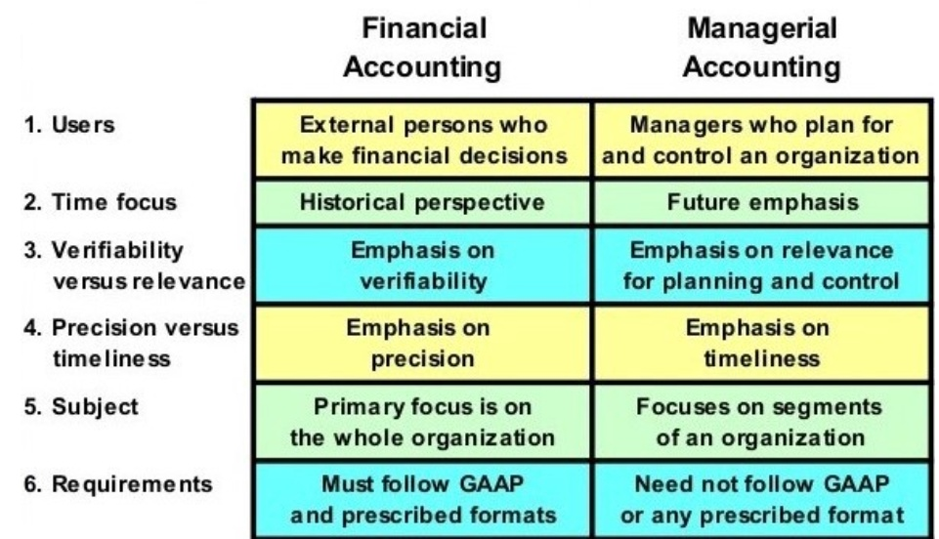
Distinction between Financial accounting and Management accounting

Slide 9
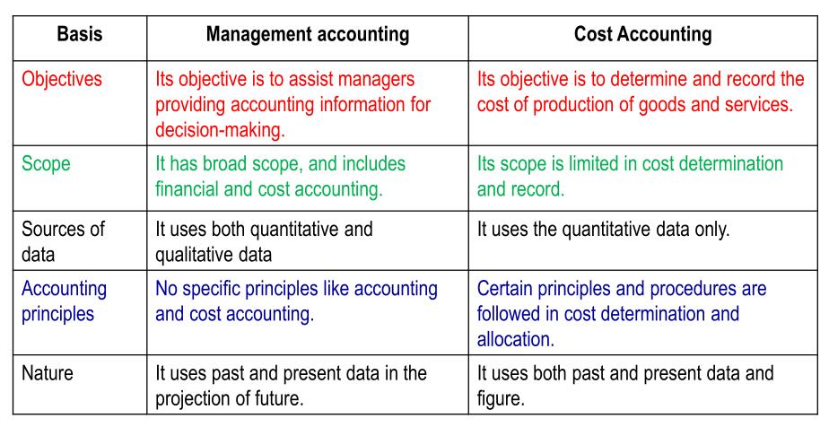
Distinction between Management accounting and Cost accounting

Slide 10
Tools and Techniques of Management Accounting
Financial policy and Accounting.
Analysis of Financial statement.
Historical cost Accounting.
Budgetary control.
Standard costing.
Marginal costing.
Management information system.
Other tools of management accounting are:
Decision accounting
Revaluation accounting
Control accounting.

Slide 11
Advantages/Merits/Uses of Management accounting.
Increase in efficiency.
Effective planning.
Performance evaluation.
Profit Maximization.
Reliability.
Elimination of wastage.
Effective communication.
Employee morale.
Control and co-ordination.

Slide 12
Limitations of Management accounting
Dependence of basic record.
Personal bias.
Management Accounting is only a tool.
Management Accounting provides only data.
Broad based scope.
Resistance to change.
Costly to Install.
Evolutionary stage

Slide 13
THANK YOU

