Slide 1
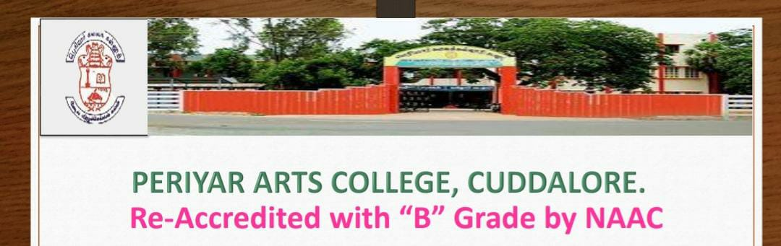
Unit 1 – part A - QuestionS and AnswerS
PG department of chemistry

Slide 2
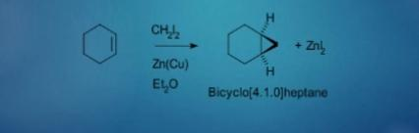
1. EXPLAIN THE SIMON-SMITH REACTION?
The Simons–Smith reaction is an organic cheletropic reaction involving an organozinc carbenoid that reacts with an alkene (or alkyne) to form a cyclopropane

Slide 3
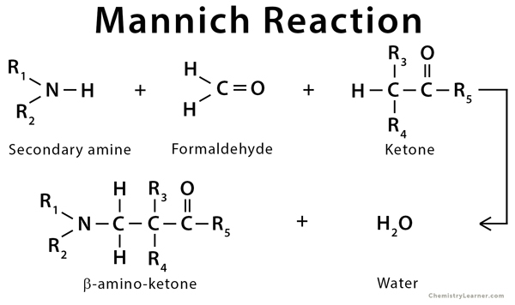
2 . What is Mannich Reaction?
The Mannich reaction is an organic reaction of an active methylene compound with formaldehyde and an amine to form a beta-aminocarbonyl compound (Mannich base) is known as Mannich reaction.

Slide 4

3.What is Wittg Horner reaction?
Wittig reaction is carried out by using phosponates, the method is called as Wittig Horner reaction.

Slide 5
4. Define Stobbe Reaction?
Dimethyl succinate and it's derivatives condense with aldehydes and ketones in the presence of bases such as NaOet,NaH etc, to give olefins or lactones or unstaturated half esters.

Slide 6
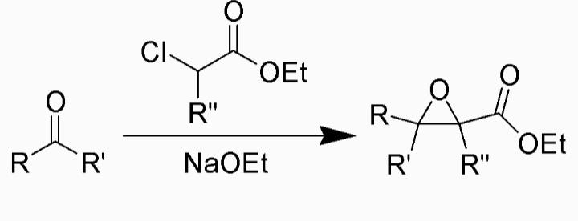
5. What are Glycidic Ester Condensation?
The chemical reaction of a ketone or aldehyde with an α-haloester in the presence of a base to form an α, β-epoxy ester, also called a "glycidic ester condensation”.

Slide 7
6. GIVE EQUVATION FOR WITTIG REACTION FOR KETENE, THIOCYANATE AND IMINE.
2
.

Slide 8
7. WHAT ARE PHOSPHOROUS YLIDE?
Phosphorous ylide is actually a carbanion stabilised by resonance with the d- orbital of adjacent phosponium cation on the carbonyl carbon of ketone.
(C₆H₅) –P=CH₂ ------→ (C₆H₅) ₃ –P⁺-C⁻H₂

Slide 9
8. WHAT ARE CARBENE?
Carbene can be defined as “neutral divalent carbon intermediate” in which a carbon covalently bonded to two atoms and has non-bonded orbitals containing two electrons in between them.
Eg: :ccl
dicholoro carbene
2

Slide 10
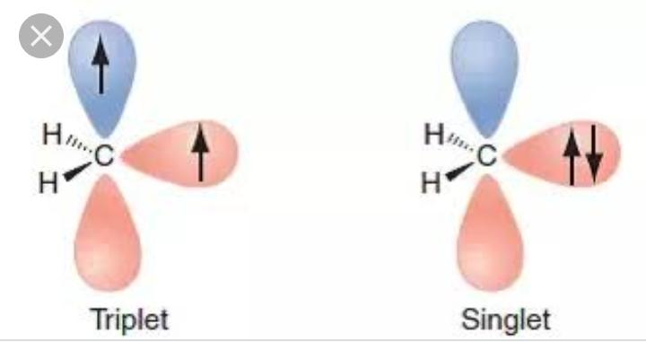
9. Structure of Carbenes?
A Singlet and Triplet Carbenes
A carbene is a neutral divalent carbon species containing two electrons that are not shared with other atoms. When these two electrons have opposite spins, the carbene is designated a singlet carbene; when they have parallel spins, the carbene is a triplet.

Slide 11
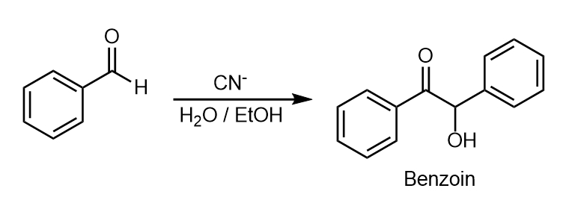
10. DEFINE BENZOIN CONDENSATION.
The benzoin addition is an addition reaction involving two aldehydes. The reaction generally occurs between aromatic aldehydes or glyoxals. The reaction produces an acyloin. In the classic application benzaldehyde is converted to benzoin.

Slide 12
11.What are the 3 Product obtained by Addition of Nocl across Double Bond.
There are two possible products when nocl added to olefins
A) Initial product is always Beta-Halo nitroso compound (A). But (A) is stable if carbon nearing nitrogen has no hydrogen atom.
B) If that carbon has hydrogen atom product (A) tautomerizes into Oxime (B).
C)With some olefins, product (A) is oxidised by Nocl to beta-halonitro compound (C).
ß

Slide 13
12.What are Nitrene?
A nitrene or imine are organic species, having general formula RN/ArN.They are nitrogen analogue of carbenes. These are electron deficient monovalent nitrogen species. Nitrogen atom in nitrene has a secret of electrons.
Stability
Tetrary >Secondary > Primary

Slide 14
13. What are the advantages of Phosphonate?
Phosphates are cheaper than the phosphonium salts.
It can be easily prepared by Arbuzov Reaction.
Phophonates are more reactive than the corresponding phosphoranes.

Slide 15
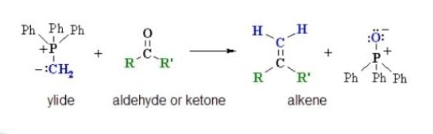
14.What is Wittig reaction?
The reaction of an aldehyde or ketone with alkylidine triphenylphospharanes to form alkene is known as Wittig reaction.

Slide 16
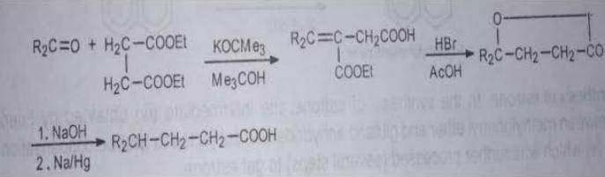
15 . Give the application of Stobbe reaction?
Stobbe condensation has been used to prepare a large number of varieties of unsaturated & saturated acids. The condensation has also been useful for the synthesis of many types of policylic ring systems.

Slide 17
                Thank you

